Slide 1
18ECC203J – Module 1 Intel 8086 – Architecture, Signals and Features S – 2
Prepared by,
Dr. R. Manohari
Dr.T.Rajalakshmi

Slide 2
S – 2 Features of 8086 microprocessor & Register organization of 8086

Slide 3
Microprocessor Definition
Microprocessor is a programmable device that takes in numbers, performs on them arithmetic or logical operations according to the program stored in memory and then produces other numbers as a result.

Slide 4
Basic Concepts of Microprocessors
Differences between:
Microcomputer –a computer with a microprocessor as its CPU. Includes memory, I/O etc.
Microprocessor –silicon chip which includes ALU, register circuits, instruction decoder circuits & control circuits
Microcontroller –silicon chip which includes microprocessor, memory & I/O in a single package

Slide 5
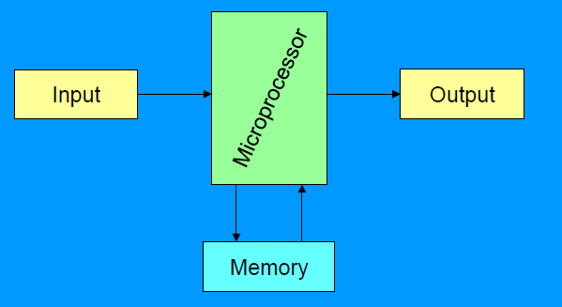
A Microprocessor based system (fig 1)

Slide 6
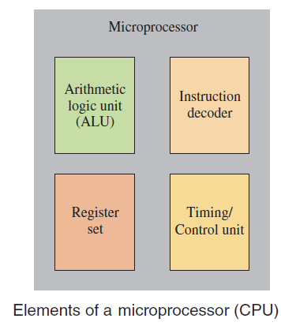
Inside the Microprocessor

Slide 7
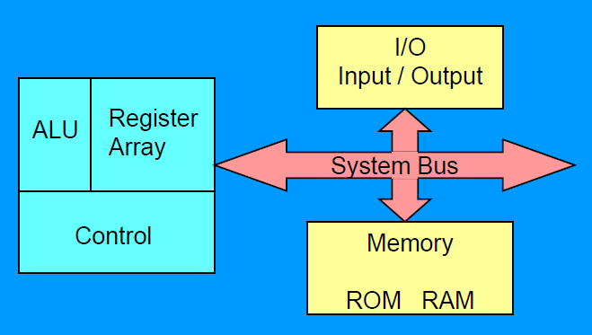
Organization of a microprocessor-based system
Let’s expand the fig 1 a bit

Slide 8
Functional blocks
Microprocessor
Computational Unit; performs arithmetic and logic operations
Various conditions of the results are stored as status bits called flags in flag register
Internal storage of data
Register array or internal memory
Data Bus
ALU
Generates the address of the instructions to be fetched from the memory and send through address bus to the memory
Flag Register
Instruction decoding unit
Timing and control unit
PC/ IP
Control Bus
Address Bus
Generates control signals for internal and external operations of the microprocessor
Decodes instructions; sends information to the timing and control unit

Slide 9
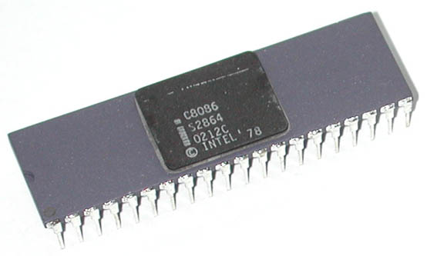
INTEL 8086
INTEL 8086 is the first 16-bit processor released by INTEL in the year 1978
Third Generation Microprocessors
Designed using HMOS technology & now it is manufactured using HMOS III technology & contains approximately 29,000 transistors.
It is available as 40-pin Dual in-line Package (DIP).

Slide 10
INTEL 8086
It is available in four versions:
8086 (5 MHz)
8086-2 (8 MHz)
8086-4 (4 MHz)
8086-1 (10 MHz)

Slide 11
Main Features of 8086
It is a 16-bit processor. It’s ALU, internal registers work with 16-bit binary words.
It has a 16 bit data bus. It can read (or write) data from (or to) a memory/port, either 16 bits or 8 bits at a time.
It has a 20-bit address bus which means it can address up to 2²⁰ = 1 MB memory location.
Like 8085, 8086 too can do only fixed arithmetic.
Intel had designed the coprocessor 8087 that can do floating point arithmetic & other complex mathematical operations.
8086 can work in conjunction with 8087 to do both fixed-point, floating point & other complex mathematical functions.

Slide 12
Main Features of 8086 cont…
It is designed to operate in two modes: minimum mode and maximum mode
In minimum mode, 8086 processor works in a single processor environment
In maximum mode, it works in a multiprocessor environment.
In a multiprocessor environment, Control signals for memory & I/O are generated by an external BUS controller
It requires +5 V power supply.
It uses a 40 pin DIP

Slide 13
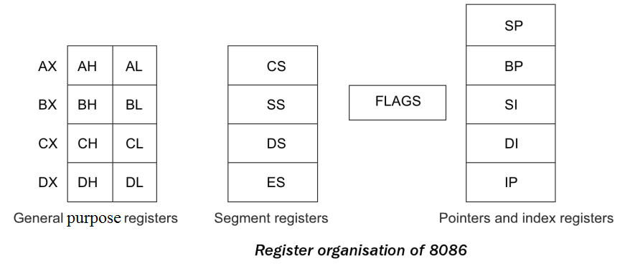
Register Organization of 8086

Slide 14
Flag Register
A flag is a flip-flop that indicates some condition produced by the execution of an instruction or controls certain operations of the EU
A 16-bit flag register in the EU contains nine active flags in the flag register

Slide 15
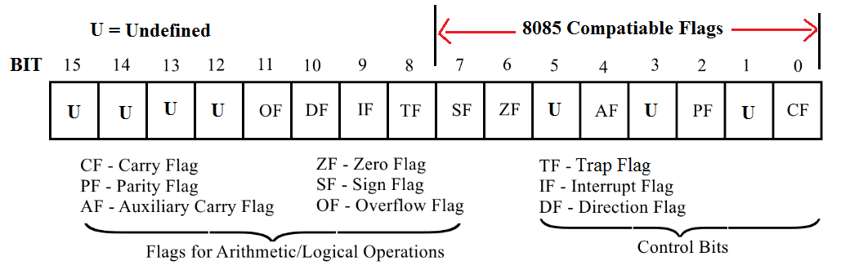
Flag Register
8086 has 9 flags and they are divided into two categories:
Condition Flags
Control Flags

Slide 16
Condition Flags
Condition flags represent result of last arithmetic or logical instruction executed. Conditional flags are as follows:
Carry Flag (CF): This flag is set if there is a carry / borrow after an integer arithmetic.
Auxiliary Carry Flag (AF): If an operation performed in ALU generates a carry / borrow from lower nibble (i.e. D₀ – D₃) to upper nibble (i.e. D₄ – D₇), then AF is set. It is used in BCD Addition.
Parity Flag (PF): This flag is used to indicate the parity of result. If the result contains even number of 1’s, the Parity Flag is set and for odd number of 1’s, the Parity Flag is reset

Slide 17
Condition Flags
Zero Flag (ZF): It is set; if the result of arithmetic or logical operation is zero else it is reset.
Sign Flag (SF): In sign magnitude format, the sign of number is indicated by MSB bit. If the result of operation is negative, sign flag is set.
Overflow Flag (OF): It occurs when signed numbers are added or subtracted. An OF indicates that the result has exceeded the capacity of machine that is result is out of range

Slide 18
Control Flags
Control flags are set or reset deliberately to control the operations of the execution unit. Control flags are as follows:
Trap Flag (TP):
It is used for single stepping through a program
It allows user to execute one instruction of a program at a time for debugging.
When trap flag is set, program can be run in single step mode.

Slide 19
Control Flags
Interrupt Flag (IF):
It is an interrupt enable / disable flag.
If it is set, the INTR interrupt of 8086 is enabled and if it is reset then INTR is disabled.

Slide 20
Control Flags
Directional Flag (DF):
It is used with string operations.
If it is set, string bytes are accessed from higher memory address to lower memory address.
When it is reset, the string bytes are accessed from lower memory address to higher memory address.

Slide 21
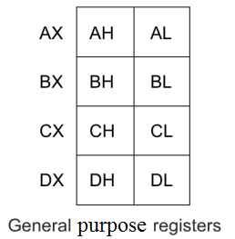
General Purpose Registers
EU has eight general purpose registers, labeled AH, AL, BH, BL, CH, CL, DH & DL
These registers can be used individually for temporary storage of 8-bit data.
The AL register is also called the accumulator
Certain pairs of these general purpose registers can be used together to store 16-bit data words
AH-AL pair --- AX register
BH-BL pair --- BX register
CH-CL pair --- CX register
DH-DL pair --- DX register

Slide 22
General Purpose Registers
AX Register: AX register is also known as accumulator register that stores operands for arithmetic operation like divided, rotate.
BX Register: This register is used as an offset storage for forming physical addresses in case of certain addressing modes.
CX Register: It is used as a default counter in case of string and loop instructions.
DX Register: DX register is used to contain I/O port address for I/O instruction.

Slide 23
Pointer and Index Registers
Stack Pointer (SP)
Base Pointer (BP)
Source Index (SI)
Destination Index (DI)

Slide 24
Pointer and Index Registers
Stack Pointer (SP):
The function of SP is same as the function of SP in Intel 8085.
It stores the address of top element in the stack.
BP, SI & DI are used
for temporary data storage just as the general purpose registers
in memory address computation. (later)

Slide 25
Base Pointer (BP), Source Index (SI), Destination Index (DI) Registers
BP : We can use it instead of SP for accessing the stack using based addressing mode.
In this case, the 20-bit physical stack address is calculated from BP and SS
SI : It can be used to hold the offset of source data in the data segment
In this case, the 20-bit physical data address is calculated from SI and DS
DI: It is used to store the offset of destination in data or extra segment
String instructions always use ES and DI to determine the 20-bit physical address for the destination

Slide 26
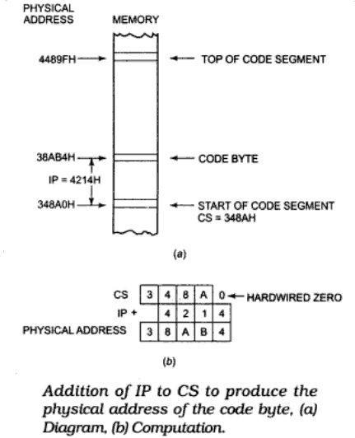
Instruction Pointer (IP)
The Instruction Pointer (IP) in 8086 acts as a Program Counter.
IP register holds the 16-bit address or offset of the next code byte within the code segment
Offset indicates displacement of the memory location from the starting location of the segment.

Slide 27
Cont.
The instruction pointer register contains a 16-bit offset which tells, where in that 64-Kbyte code segment the next instruction byte is to be fetched from.

Slide 28
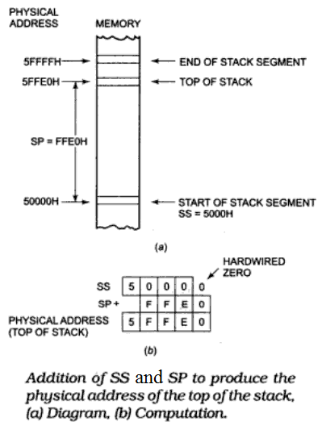
Stack Pointer Register
The SP register in the EU holds the 16-bit offset from the start of the stack segment to the top of the stack
For stack operation, the content of the SS register and the content of the SP register are used to produce the 20-bit physical address.

Slide 29
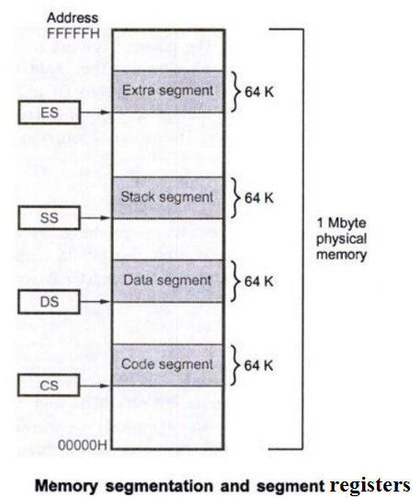
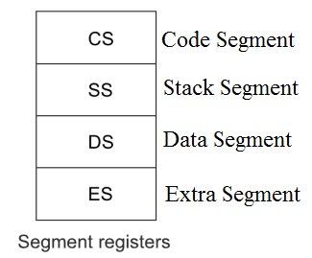
Segment Registers
Unlike 8085, the 8086 addresses a segmented memory
A segment register points to the starting address of a memory segment.

Slide 30
Segment Registers
Four Segment registers in the BIU are used to hold the upper 16 bits of the starting addresses of four memory segments that the 8086 is working with at a particular time

Slide 31
Segment Registers
Code Segment Register: Used to hold the upper 16 bits of the starting address of code segment from which the BIU is currently fetching instruction code bytes
Data Segment Register & Extra Segment Register: Used to hold the upper 16 bits of the starting addresses of data segment and extra segment that are used for data
Stack Segment Register: Used to hold the upper 16 bits of the starting addresses of stack segment which is used to store stack data

Slide 32
References
Advanced Microprocessors and Peripherals by A K Ray & K M Bhurchandi
Microprocessors and Interfacing by Douglas V Hall & SSSP Rao

Slide 33
Thank You

